Slide 1
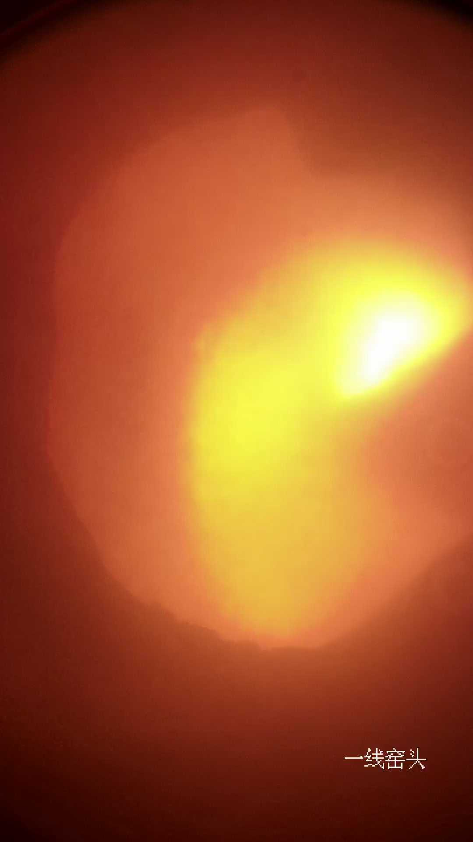
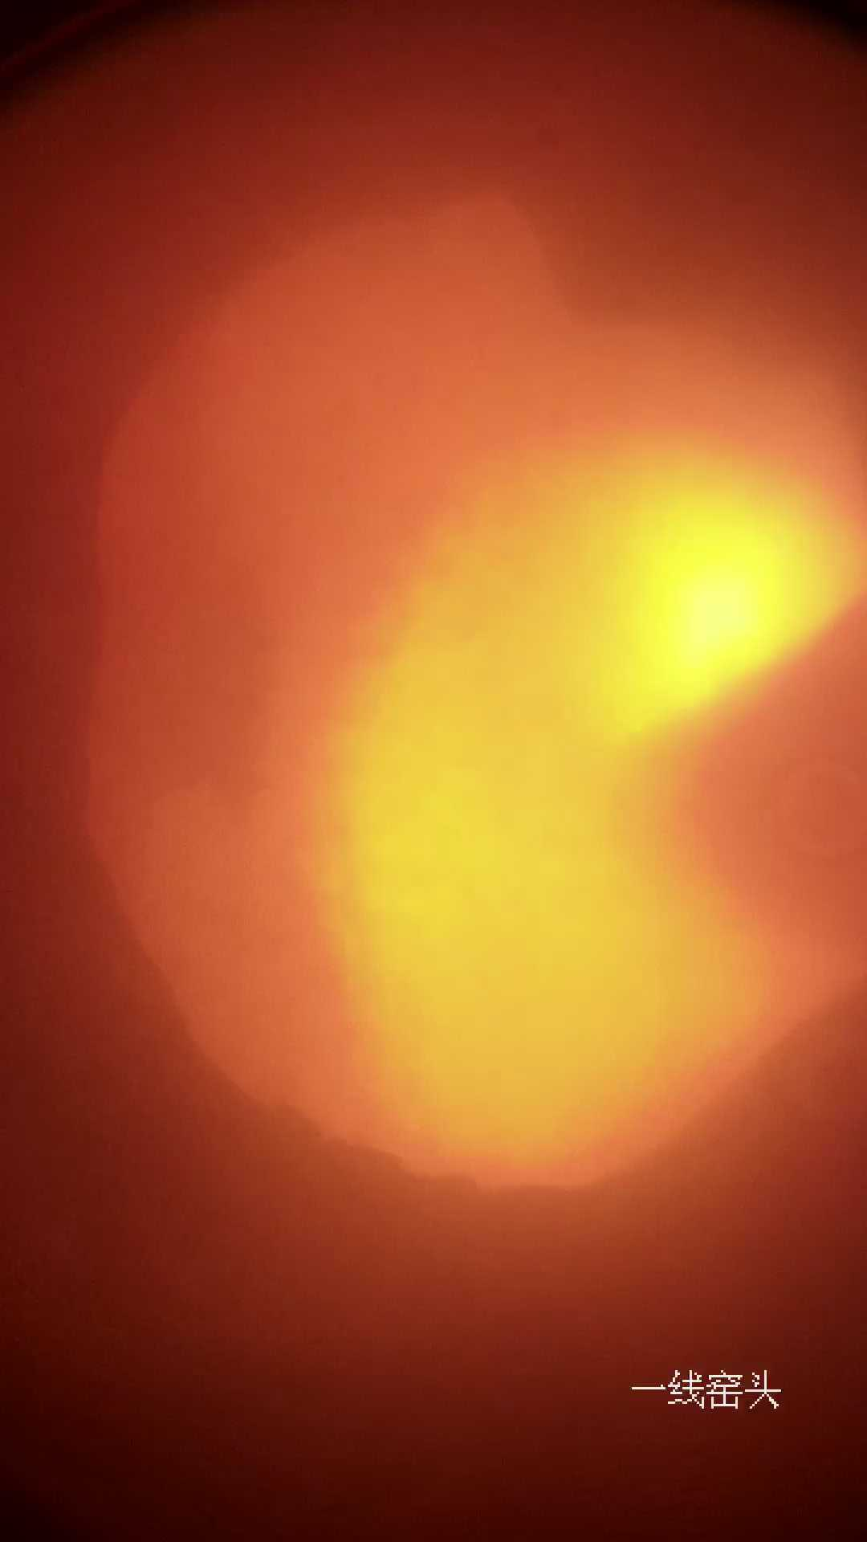
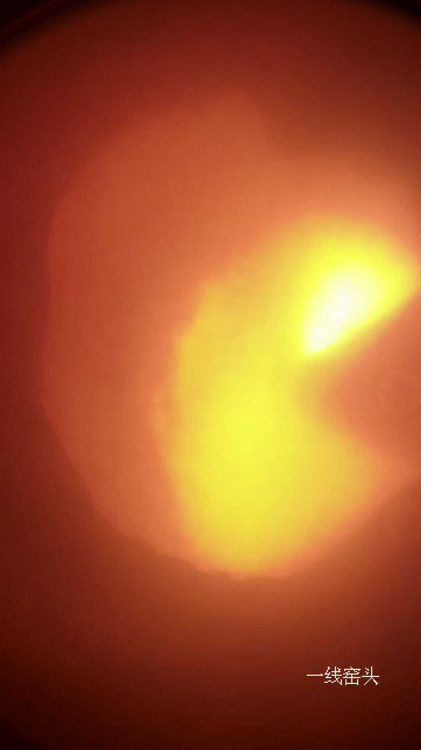
Gas flow
Material flow
High temperature fan
Fuel flow
Captured flame images
Cyclone preheater
Coal storage
Preheating air duct
Coal tube
Coal mill
Material pipe
Tertiary wind tube
Kiln head
Precalciner
Primary air fan
Grate cooler
Kiln tail
M
To sampling and analyzing equipment
Cement clinker
Motor
Cooler fan
Preheating process, duration ≈ 5min
Calcinating process, duration ≈ 30min
Cooling process, duration ≈ 20min

